Slide 1
ADI1201 – Data Exploration & Visualization FINAL REVIEW
Department of Artificial Intelligence and Data Science
Year : II year Sem : III Semester
Team 17
Members :
DHARSHINI K - 927623BAD023
GAYATHRI C - 927623BAD034
JEEVA K - 927623BAD045

Slide 2
Energy Saver

Slide 3
Abstract
This project analyzes energy consumption data from smart meters using Python's pandas library. By applying statistical methods and data visualization techniques, it uncovers patterns and trends in energy usage. The goal is to help users understand their consumption habits, identify inefficiencies, and provide recommendations for energy-saving measures. Ultimately, the project aims to reduce costs and environmental impact, promoting more sustainable energy practices.

Slide 4
Introduction
With the growing focus on sustainability and energy conservation, smart meters have become essential tools for monitoring energy consumption. These devices provide real-time data, helping both consumers and utility providers make informed decisions. However, the vast amount of data generated requires effective analysis to extract valuable insights. This project utilizes Python's pandas library to analyze smart meter data, uncovering consumption patterns and trends. By identifying anomalies and offering recommendations for energy-saving measures, we aim to help users reduce costs and minimize their environmental impact, contributing to more sustainable energy practices.

Slide 5
Methodology
Data Collection
Dataset Acquisition
Data Cleaning
Data Transformation
Data Analysis
Descriptive Statistics
Time Series Analysis
Anomaly Detection.
Data Visualization
Energy-Saving Measures

Slide 6
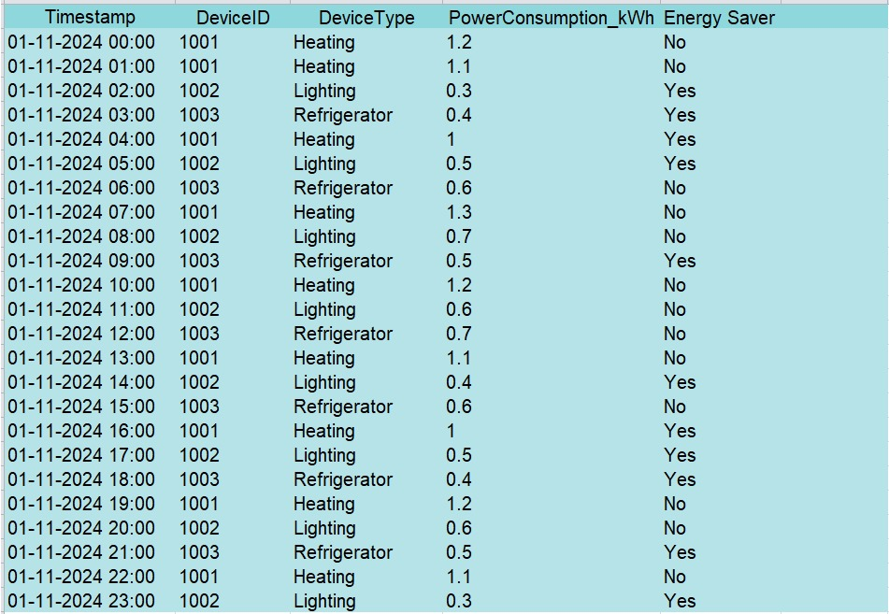
DATA SET

Slide 7
Key Concepts to Analyze
Smart Meter Technology:
Devices that monitor and record real-time energy usage, enabling detailed analysis.
Energy Consumption Metrics:
Power consumption in kilowatt-hours (kWh), peak usage times, and device-specific energy usage.
Data Analysis Tools:
Python's pandas library for data manipulation and visualization tools like Matplotlib and Seaborn for graphical insights.
Sustainability:
Minimizing energy waste and promoting environmentally friendly practices through informed decision-making.
Statistical Techniques:
Trend analysis, correlation, anomaly detection, and energy efficiency comparisons.

Slide 8
Proposed Architecture
Data collection
Energy saving
Data cleaning
SMART METER
Data
Visulaization
Data analysis
Data transform

Slide 9


Data Visualization Tools
Software's Used:
Matplotlib
To create static, interactive, and visually appealing plots.
Seaborn
For statistical data visualization with a focus on clarity and aesthetic visuals.
Programming Language:

Slide 10
CODE :
from flask import Flask, render_template, request, redirect, url_for
import pandas as pd
import os
import matplotlib.pyplot as plt
import seaborn as sns
import plotly.express as px
app = Flask(__name__)
UPLOAD_FOLDER = 'uploads'
app.config['UPLOAD_FOLDER'] = UPLOAD_FOLDER
if not os.path.exists(UPLOAD_FOLDER):
os.makedirs(UPLOAD_FOLDER)
# Global variables to store uploaded dataset and file name
uploaded_data = None
uploaded_file_name = None
@app.route('/', methods=['GET', 'POST'])
def index():
global uploaded_data, uploaded_file_name
message = None # For status feedback
if request.method == 'POST':
# Check if the POST request has the file
if 'file' not in request.files:
message = "No file part in the request."
return render_template('index.html', message=message)

Slide 11
CODE :
file = request.files['file']
if file.filename == '':
message = "No file selected for uploading."
return render_template('index.html', message=message)
# Save the file
file_path = os.path.join(app.config['UPLOAD_FOLDER'], file.filename)
file.save(file_path)
# Load the file into a DataFrame
try:
if file.filename.endswith('.csv'):
uploaded_data = pd.read_csv(file_path)
elif file.filename.endswith('.xlsx'):
uploaded_data = pd.read_excel(file_path)
else:
message = "Unsupported file type. Please upload a CSV or Excel file."
return render_template('index.html', message=message)
uploaded_file_name = file.filename
message = f"File '{uploaded_file_name}' uploaded successfully!"
except Exception as e:
message = f"Error processing the file: {e}"

Slide 12
CODE :
return render_template('index.html', message=message, uploaded_file_name=uploaded_file_name)
@app.route('/visualize', methods=['GET'])
def visualize():
global uploaded_data
if uploaded_data is None:
return "No data uploaded. Please upload a dataset first."
try:
# Convert Timestamp column to datetime
if 'Timestamp' in uploaded_data.columns:
uploaded_data['Timestamp'] = pd.to_datetime(
uploaded_data['Timestamp'], format='%d-%m-%Y %H.%M', errors='coerce'
)
# Add Hour column if Timestamp exists
if 'Timestamp' in uploaded_data.columns:
uploaded_data['Hour'] = uploaded_data['Timestamp'].dt.hour
# Aggregation: Power Consumption by Hour
if 'Hour' in uploaded_data.columns and 'PowerConsumption_kWh' in uploaded_data.columns:
hourly_consumption = uploaded_data.groupby('Hour')['PowerConsumption_kWh'].mean().reset_index()

Slide 13
CODE :
# Create a Matplotlib plot
plt.figure(figsize=(10, 5))
sns.lineplot(x='Hour', y='PowerConsumption_kWh', data=hourly_consumption, marker='o', color='b')
plt.title("Hourly Average Power Consumption")
plt.xlabel("Hour of the Day")
plt.ylabel("Power Consumption (kWh)")
plot_path = os.path.join("static", "hourly_consumption.png")
plt.savefig(plot_path)
plt.close()
else:
plot_path = None
# Create an interactive Plotly visualization
if 'DeviceType' in uploaded_data.columns and 'DeviceID' in uploaded_data.columns:
fig = px.sunburst(
uploaded_data, path=['DeviceType', 'DeviceID'], values='PowerConsumption_kWh',
color='PowerConsumption_kWh', color_continuous_scale='RdYlGn',
title="Power Consumption Hierarchy"
)
sunburst_html = fig.to_html(full_html=False)
else:
sunburst_html = "No DeviceType or DeviceID columns available for visualization."
except Exception as e:
return f"An error occurred during visualization: {e}"

Slide 14
CODE :
return render_template('index.html', plot_path=plot_path, sunburst_chart=sunburst_html)
if __name__ == '__main__':
app.run(debug=True)

Slide 15
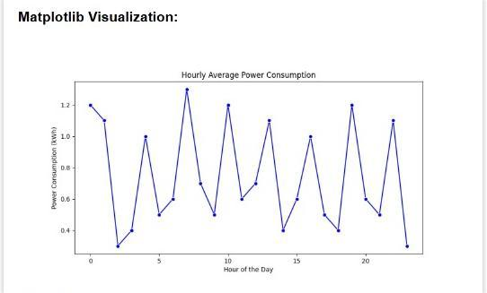
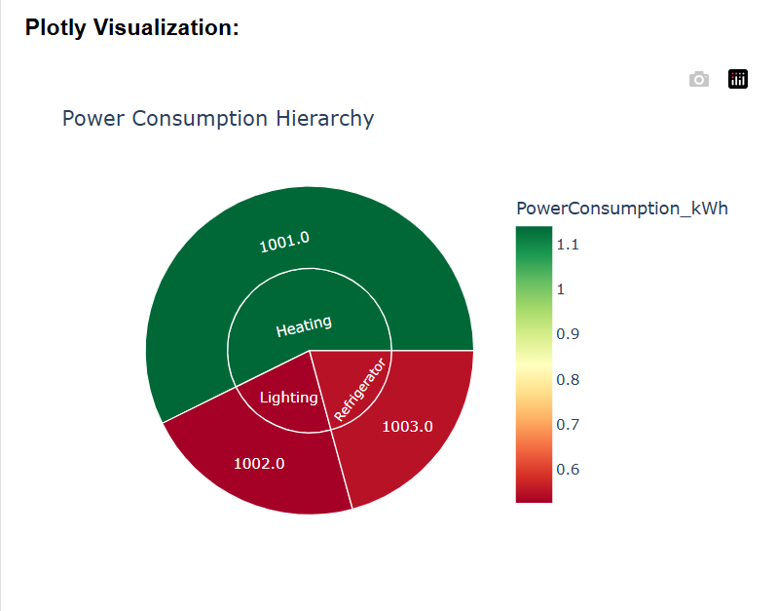
Output :

Slide 16
Potential Challenges
Advantages
Cost Savings
Sustainability
Real-Time Monitoring
Customization
Data-Driven Insights
Data Quality Issues
Large Volume of Data
Device-Specific Variations
User Awareness

Slide 17
CASE STUDY :
Residential Energy Usage Analysis
Industrial Energy Management
Commercial Building Optimization
Energy-Saving Comparison Between Old and Smart Appliances
Energy Efficiency in Schools or Colleges
Renewable Energy Integration
Smart City Energy Analysis

Slide 18
REFERENCE :
Python for Data Analysis by Wes McKinney – Comprehensive guide on using pandas for data manipulation.
Energy.gov – Resources on energy-saving measures and smart meter technologies.
Kaggle – Open datasets for energy consumption analysis.
Matplotlib and Seaborn documentation – Guides for creating effective visualizations.
IEEE Xplore – Research papers on energy efficiency and smart meter analytics.

Slide 19
Thank You

